Slide 1

Catalog Cross Selling
Group 6
Kalpesh Odedra
Suraj Rampure
Mirza Razin Alam
Sreeja Thazhathethil
Yagna Himachalapathy
Bensy Chitteth

Slide 2
Agenda
Background
Objective
Methodology
Data Gathering , Cleaning
Data transformation & Enhancement
Data Analysis & Visualization
Results
Recommendations
Conclusion

Slide 3
Background
Exeter, Inc. is a catalog firm that sells products in a number of different catalogs that it owns. The catalogs number fall into nine basic categories which are Clothing, Housewares, Health, Automotive, Personal electronics, Computers, Garden, Novelty gift, and Jewelry.
Exeter wants to take every opportunity to promote their products by using the following approaches in the cross-promotion platform:
Providing catalog when selling a product
Enclosing a catalog in the shipment of a purchased product

Slide 4
Objectives
Provide
Provide a higher probability catalog that induces a purchase to promote products to the customers to try to sell them additional catalog while we have their attention
Create
Create an association rule set where catalogs chosen for cross promotion has a higher probability of inducing a purchase than randomly selected catalog.
Select
Select item-sets and assign discount for a more effective strategy to induce purchase.

Slide 5
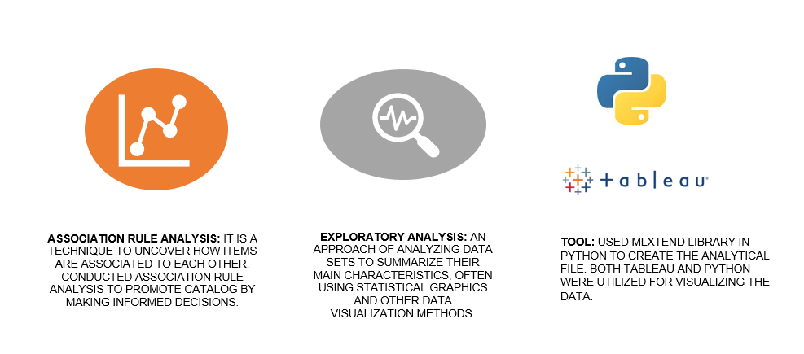
Methodology
Association Rule Analysis: It is a technique to uncover how items are associated to each other. Conducted Association Rule Analysis to promote catalog by making informed decisions.
Exploratory analysis: through visualization

Slide 6
Data Gathering, Cleaning
The dataset for this case study was provided in a .csv file
Cleaning the datasets was done using python(Pandas Library) . The missing values and irrelvant columns were removed.

Slide 7

Data transformation & Enhancement
Used Apriori algorithm to create association rules and identify frequent data item sets.
Filter-in values where antecedents length is less than 2 and consequent length is 1.
We have set the Min confidence to 0.5.

Slide 8
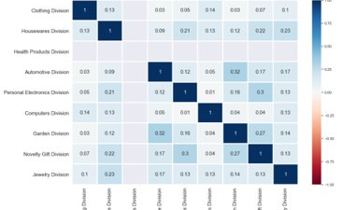
Exploration
No strong correlation between each categories.
Therefore, correlation cannot be used to guess which categories go together.

Slide 9
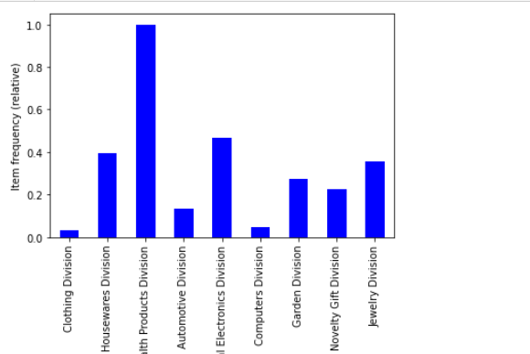
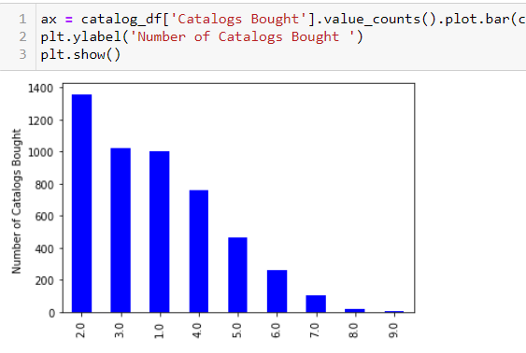
Data Analysis & Visualization
Frequency of each category
Frequency of catalogs bought by one customer

Slide 10
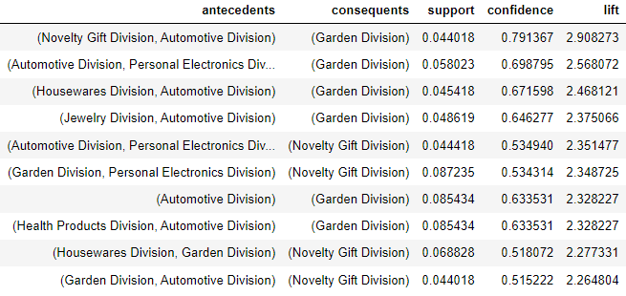
If this, then that
When Novelty & Auto catalogs are purchased
Garden division catalog has the highest likelihood of purchase
Lift = 2.9

Slide 11
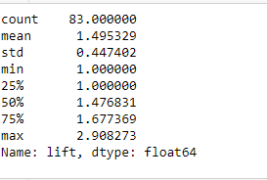

Results
Total 83 item sets
Upper 25% of lift values from 1.67 to 2.9
Out of the 83 item sets, 21 of the observations had lift values of 1.67 or above. 11 observations had lift values of 2 or above.
Item sets with lift of 2.9 has 2.9 times more probability of purchase than a randomly selected itemset, for cross-promotion.
All the item sets in the selected rule have confidence of more than 0.5

Slide 12
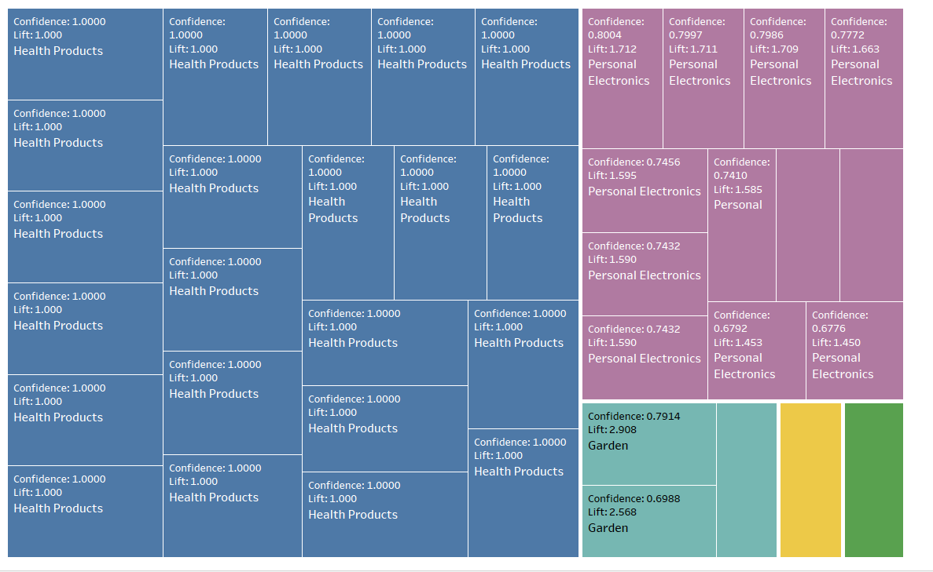
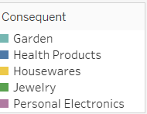

Antecedent Confidence with Consequent
Health Products and Personal Electronics with any antecedent has high confidence.
Their lift values are low.

Slide 13
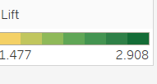
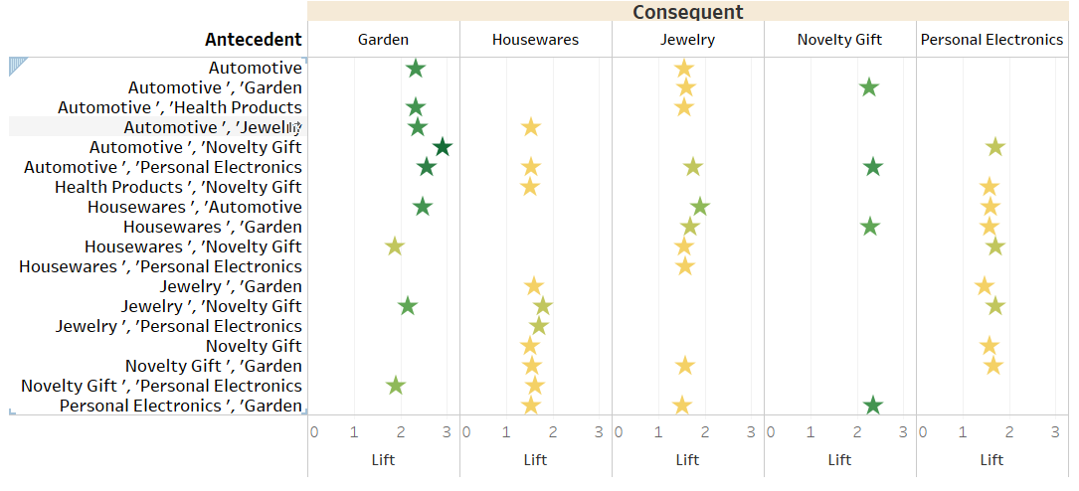

Antecedents with highest lift
Garden has the highest lift values. Therefore, it’s a good candidate for promotion.
Personal Electronic consequent with Novelty gift antecedent would help sell more catalogs.
Houseware division with novelty division has most confidence.

Slide 14
Recommendations
Discounts should be divided in high, medium and low and distributed based on the lift tier system below.
Tier-1:Lift > 2
To maximize chances of purchase the item-sets with lift more than 2 should be attached with a lower discount since this set already has a high chance of purchase.
Mode of delivery can be physical delivery.
Tier-2 : Lift > 1.67 & < 2
Item-sets with lift of 1.67 and 2 should be attached a medium discount to increase the chance of purchase even more.
The mode of delivery can be through email since it's a more cost-effective option.
Tier-3: Lift > 1.47 & < 1.67
Item-sets with lift 1.47 and 1.67 should be given a higher discount to increase the likelihood of purchase.
Mode of delivery through email.

Slide 15
Recommendations
On top of lift tiers, we also recommend targeting people who bought 1 or 2 or 3 catalogs together differently.
1002 People bought 1 catalog
1358 customers bought 2 catalogs.
These customers can be given some discounts but mostly the customers with item set lifts >1.67 should be given higher priority and physical delivery mode.
3 or more catalogs bought.
If lift is >2 then we suggest using physical delivery mode else use email for delivery.
Since these customers bought only 1 catalog and frequency of buying 2 is the highest. Therefore, these are the prime candidates for up-selling.
Using the lift tier system, they should be targeted first and with more incentives in discounts .ie. Higher discounts for all 3 tiers and physical delivery mode.
Customers with lift <1.67 can be given discounts with email.
Since these customers already bought 3 or more catalogs the chance of buying more is reduced.

Slide 16
Conclusion
Garden division and the novelty have the highest frequency in consequent with a higher lift value. These catalog that could be promoted as they have the highest lift, thereby has a higher chance of conversion.
Using the association model, we identified a strong association between sets of items bought together.
More products can be launched and promoted to observe how it works for the business.

Slide 17
Thank You

